Slide 1
MaliPUty
Progress report

Slide 2
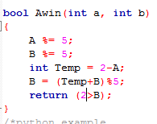
The RPS code
B
A
-2
-2 -1 0 1 2 3 4

